Slide 1
CIFAR-10 CNN
<Jagadeesh>

Slide 2
Overview This project aims to develop and train Convolutional Neural Networks (CNNs) to classify images from the CIFAR-10 dataset. The CIFAR-10 dataset is a widely recognized benchmark in machine learning and computer vision, consisting of 60,000 32x32 color images across 10 classes: airplanes, cars, birds, cats, deer, dogs, frogs, horses, ships, and trucks. Dataset:- CIFAR-10 The CIFAR-10 dataset is divided into a training set of 50,000 images and a test set of 10,000 images. Each image is labeled with one of the 10 classes. The images are small (32x32 pixels) and colored, providing a challenging task for classification due to their size and the similarity between classes.

Slide 3
Requirements
Python 3.x
TensorFlow 2.x or higherNumPy
Matplotlib (for plotting results)

Slide 4
Model Architecture
The model is a straightforward CNN with the following layers:
Conv Layer 1: 32 filters, 3x3 kernel, ReLU activation, MaxPooling (2x2), 25% dropout.
Conv Layer 2: 64 filters, 3x3 kernel, ReLU activation, MaxPooling (2x2), 25% dropout.
Conv Layer 3: 128 filters, 3x3 kernel, ReLU activation, MaxPooling (2x2), 25% dropout.
Fully Connected Layer: 512 units, ReLU activation, 50% dropout.
Output Layer: Softmax activation for classification into 10 classes.
The model is trained using categorical cross-entropy loss and the Adam optimization algorithm.

Slide 5
Training and Evaluation
.
The model is trained on the CIFAR-10 training dataset for a specified number of epochs. During training, categorical cross-entropy loss and the Adam optimizer are used to update the model weights. After each epoch, the model's accuracy is evaluated on the CIFAR-10 test dataset to monitor performance. The final test accuracy, representing the model's ability to generalize to unseen data, is reported at the end of training. Early stopping and learning rate adjustments may be applied to enhance training efficiency and prevent overfitting.

Slide 6
Results
After training for 100 epochs, the model is expected to achieve an accuracy of approximately 75-88% on the CIFAR-10 test dataset. The exact performance can vary due to factors like random initialization of weights and chosen hyperparameters. Adjustments in learning rate, batch size, and dropout rates may further influence the results. Regular monitoring and tuning are essential to optimize the model’s performance and achieve the best possible accuracy within the expected range.

Slide 7
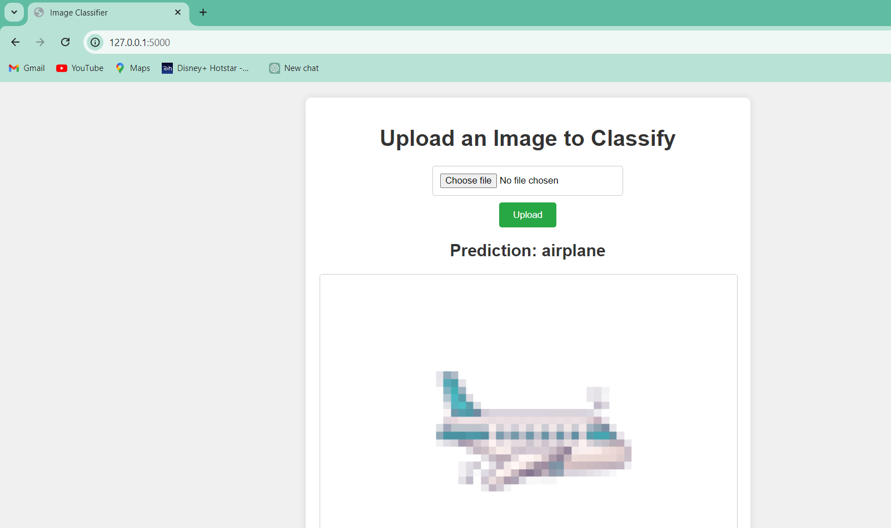

Slide 8
Conclusion
This project illustrates the effectiveness of CNNs in classifying CIFAR-10 images with good accuracy. It serves as a fundamental example, showcasing a straightforward CNN architecture. This baseline model offers a solid foundation for further experimentation and enhancements. Future improvements could involve using deeper networks, incorporating more sophisticated architectures, or applying advanced techniques like data augmentation to boost performance. By building on this basic model, researchers and developers can explore various strategies to achieve higher accuracy and better generalization in image classification tasks

